Slide 1

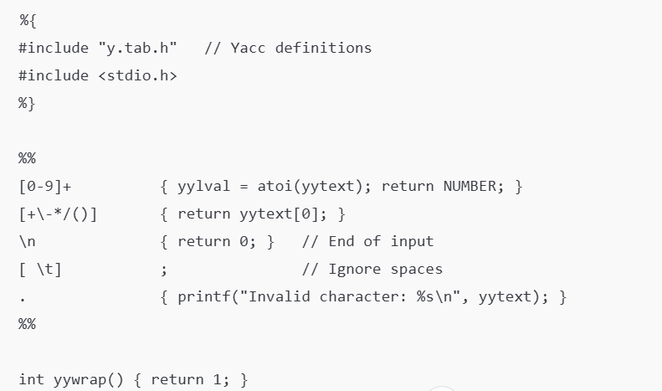
Implementation of calculator using lex and yacc
Write a LEX file to tokenize input, and a YACC file to parse & evaluate expressions.

Slide 2

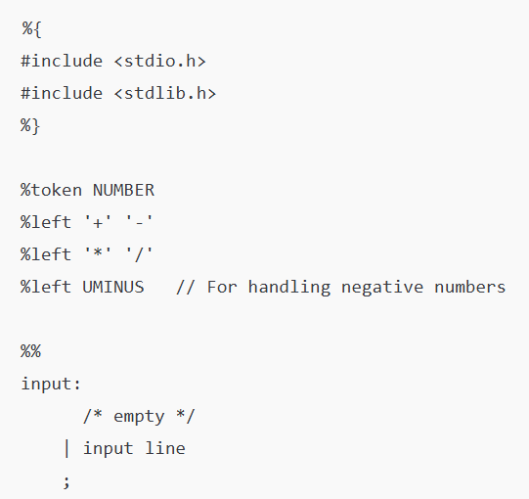

Slide 3
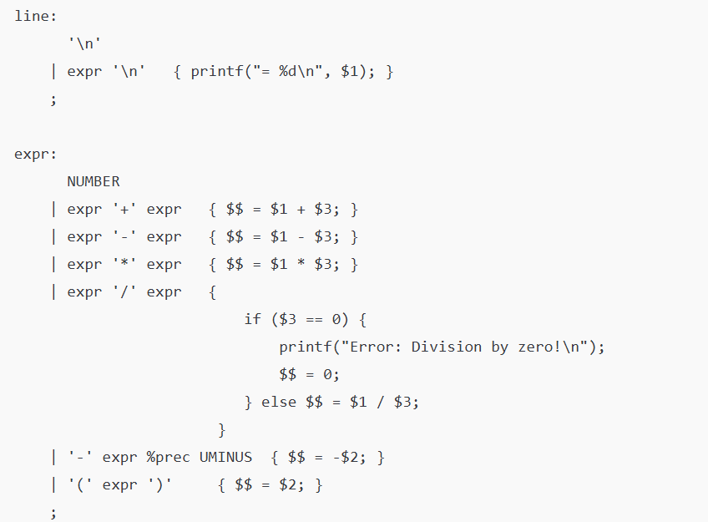

Slide 4

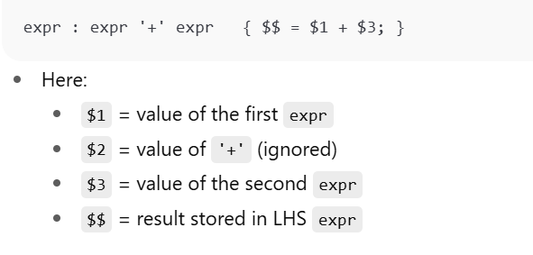


Slide 5
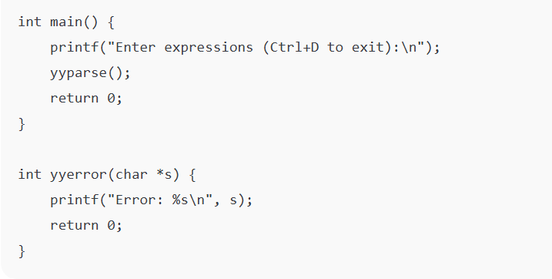

Slide 6



Slide 7
